Slide 1

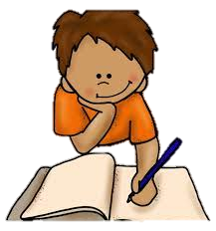



All About Me
Year 7 Health
Lesson 2
2024

Slide 2

DUE:
A letter to me!
DUE: At the start of the lesson (week 2)
Last week you were tasked with writing a letter to yourself.
This is due at the start of the lesson.
Please make sure your name is on it, the envelope is sealed and place it on the teacher’s desk.
DUE TODAY

Slide 3
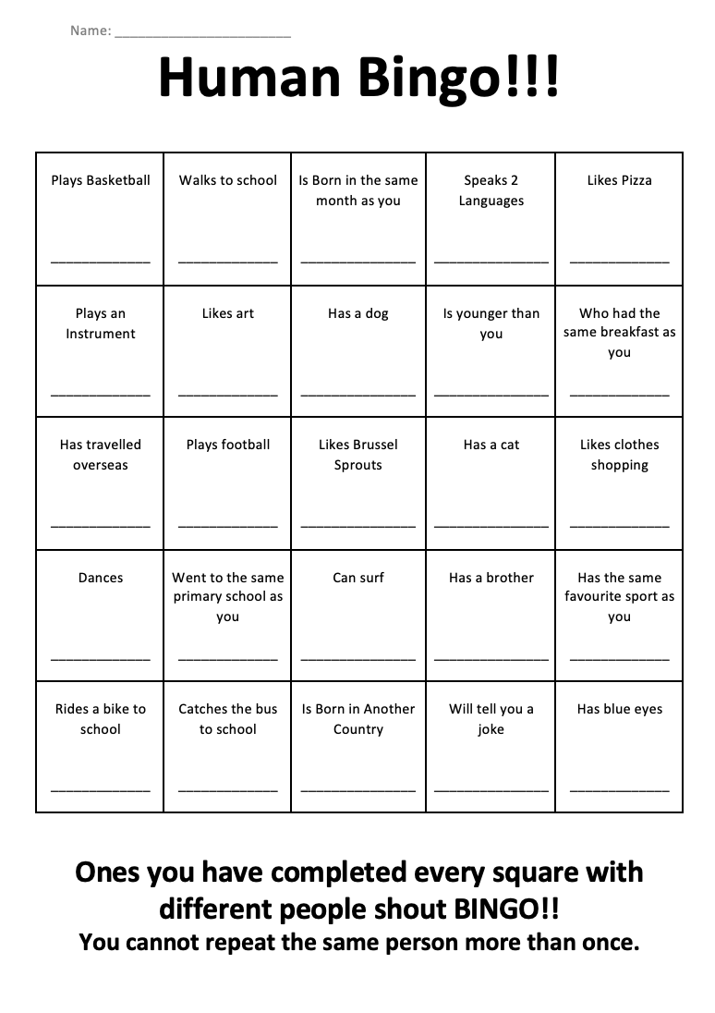
Optional hook: person bingo (Pg. 8)
In your books is a bingo grid.
You have 5 minutes to walk around the class and speak to different people to try and fill your bingo board.
You cannot repeat the same name more than once.
Prizes up for grabs!!
      First bingo across
      First bingo up and down
      First bingo diagonal
Notes:
You can change the number of times a name is repeated if it’s too hard.
You can choose between this and ‘things change’ as a hook.

Slide 4
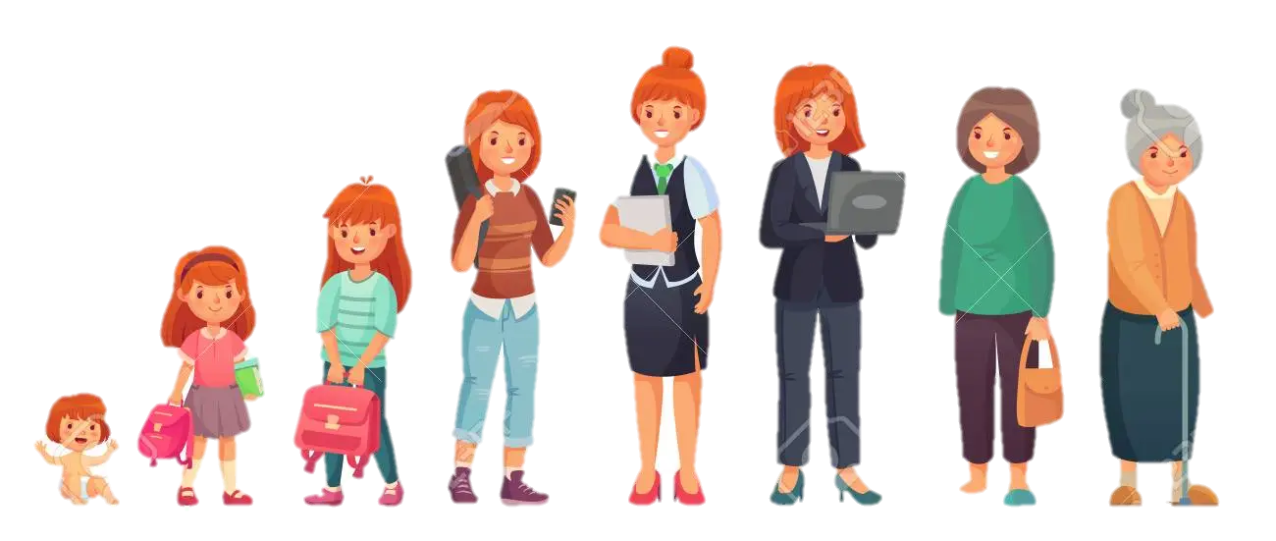
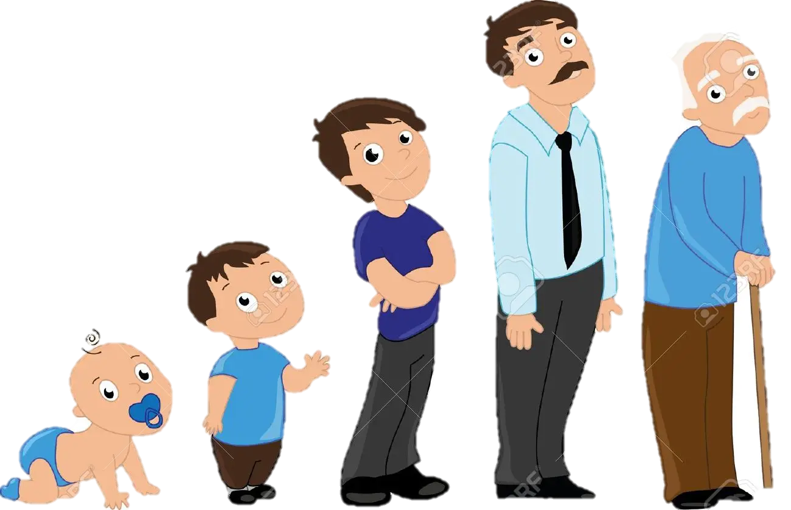
Optional HOOK: Things Change (Pg. 9)
Complete the boxes to show how you have changed over time, since Kindergarten to Year 7, and explain why you think these changes have occurred.
Do you still play the same sport as you once did?
Do you still have the same friendship group?
Are you the same height?
As we grow older we start to mature and change both physically and emotionally. The friends we once had may not be the same and this can be for different reasons. As people get older, their personal experiences shapes who they are and how they will respond in the future. Some people have a more natural growth which is shaped by how they believe they should react in different situations.
Notes:
You can choose between this and human bingo as a hook.

Slide 5


ACTIVITY 1:
Overcoming setbacks (Pg. 10)
Think about a time when you have experienced a challenge or set back.
Write a personal story about this situation.
      What happened in the scenario?
      How did it make you feel?
      What did you do to overcome the challenging time or setback?
Be willing to share your story with the class!
You have 15 minutes to write your story.
Notes:
Assessment 2 related

Slide 6

Assessment Task 1: All about me
Due: week 4
Two whole weeks to complete at home.
Create a poster all about yourself!
Notes:
Hand out Assessment Task 2
Optional – lesson to work on assessment in class in time permits
Teacher discretion – can be hard copy or electronic on Canva

Slide 7

Optional Reflection:
Personality quiz (Pg. 11)
Visit the link below:
https://www.biteback.org.au/Quiz/PersonalityQuiz?IsMFC=true
Answer the questions as honestly as possible.
Read your results at the end and summarise into your book.
Notes:
This can be an additional/optional activity or set as a reflection activity for homework.

